Slide 1
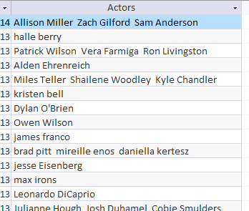
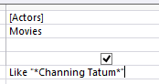
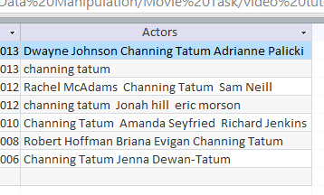
Wild Card – Sometimes a field may contain more than one word. To find something specific you need to write a wildcard search. Like “*Channing Tatum *”
Between | Between 01/01/2012 And 31/12/2012 Between 15 And 16
Or | North Sea Or Irish Sea
Not | Not “Horror”
<90 | Less than <90
>90 | More than >90
>=90 | More than and equal to >=90
37*____ | Fields starts with 37
____*37 | Fields Ends with 37
Only field containing Channing Tatum are shown

Slide 2
Movies in stock Code end in 22 & Price is between 15 and 16 Pounds
Movies in stock; Code start with 11 & Release Date is 2013
Owen Wilson Movies released before 2010
Patrick Wilson DVD Movies with a price less than £10
2012 Blue-ray movies which are not horror with a duration between 105 and 135.
Movies not in stock which have sold between 5 and 10 movies and not including horror.
Stocked Movies with a released date after June 2013, Action or drama
Movies not in stock which have 5 or less sold and are not adventure
DVD Movies with no rating, released in 2012 and after
Movies sales between 7 and 20 with a price more than and equal to £12
Stock code which includes 9003

